Slide 1

IIIT NAGPUR

Slide 2

Dc motor speed controller using 555ic timer
By Bread-board, Proteus, Simulink, Mat-lab,
Tinkeer-Cad.
Notes:
NOTE:
To change the image on this slide, select the picture and delete it. Then click the Pictures icon in the placeholder to insert your own image.

Slide 3
GROUP MEMBERS
S.no | Name of the Student | Enrollment-No
1) | Anand Gutta | BT20ECE072
2) | Guna Sai Kiran Nekkanti | BT20ECE075
3) | Nithin Jathoth | BT20ECE071
4) | K. Venkata Praneeth | BT20ECE043
THIRD YEAR –ECE-BATCH 02-GROUP1

Slide 4
DRAFT
INTRODUCTION
COMPONENTS REQUIRED
CIRCUIT DIAGRAM
WORKING
OTHER SIMULATIONS
ADVANTAGES AND DISADVANTAGES
APPLICATIONS
PRECAUTIONS
CONCLUSION
REFERENCE

Slide 5
INTRODUCTION

Slide 6
INTRODUCTION
PWM (Pulse Width Modulation) One method that is Often used for DC motor control using a microcontroller is Pulse Width Modulation (PWM) method. The speed Of the electric motor depends on the modulator voltage. The greater the voltage, the faster the rotation Of an electric motor.
This project is designed to control the speed of a DC motor using PWM control using 555 IC. The speed of the DC motor is directly proportional to the voltage applied across its terminals. Hence, if the voltage across the motor terminal is varied, then the speed can also be varied.

Slide 7
What is DC Motor?
A DC MOTOR is any of a class of rotary electrical motors that converts direct current electrical energy into mechanical energy .The most common types rely on the forces produced by magnetic fields. Nearly all types of DC motors have some internal mechanism, either electromechanical or electronic , to periodically change the direction of current in part of the motor.

Slide 8
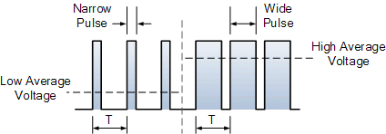
What is PWM(Pulse width Modulation)?
Pulse-width modulation(PWM), or pulse-duration modulation(PDM), is a method of reducing the average power delivered by an electrical signal, by effectively chopping it up into discrete parts.
The average value of voltage fed to the load is controlled by turning the switch between supply and load on and off at a fast rate. The longer the switch is on compared to the off periods, the higher the total power supplied to the load.
Along with maximum power point tracking(MPPT), it is one of the primary methods of reducing the output of solar panels to that which can be utilized by a battery

Slide 9
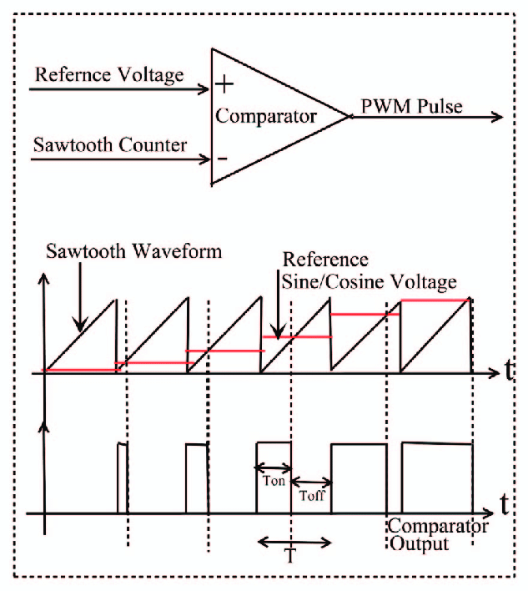
PWM Signal using Swatooth
The simplest analogue form of generating fixed frequency PWM is by comparison with a linear slope waveform such as a sawtooth. As seen in figure. 1.3, the output signal goes high when the sine wave is higher than the sawtooth.
This is implemented using a comparator whose output voltage goes to logical value HIGH when the non-inverting input (+) is greater than the other (-).
Other signals with straight edges can be used for modulation. A rising ramp carrier will generate PWM with Trailing Edge Modulation.

Slide 10
Components required

Slide 11
COMPONENTS REQUIRED
IC555 TIMER
RESISTORS
DIODES
CAPACITORS
TRANSISTOR
DC MOTOR
BATTERIES
POTENTIO METER

Slide 12
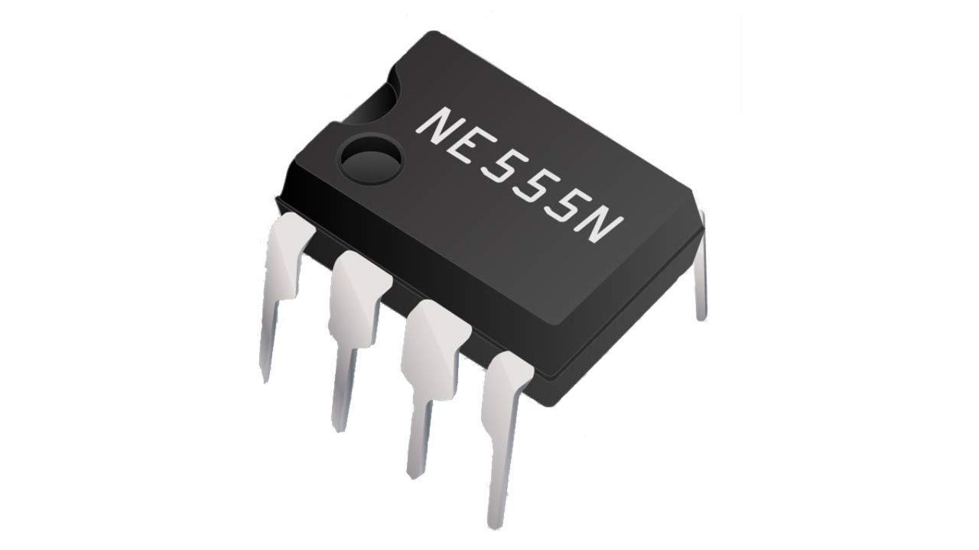
IC555 TIMER
The 555 timer IC is an integrated circuit (chip) used in a variety of timer, delay, pulse generation, and oscillator applications. Derivatives provide two (556) or four (558) timing circuits in one package.
The design was first marketed in 1972. Since then, numerous companies have made the original bipolar timers, as well as similar low-power CMOS timers.
In 2017, it was said that over a billion 555 timers are produced annually by some estimates, and that the design was "probably the most popular integrated circuit ever made"

Slide 13
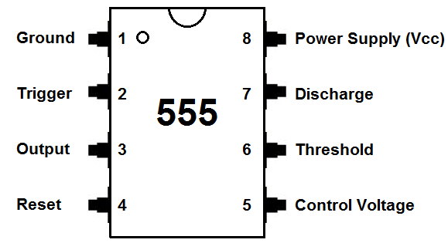
IC CIRCUIT DIAGRAM

Slide 14
PINS DESCRIPTION
GND Pin :Pin-1 is a GND pin which is used to supply a zero voltage to the IC.
Trigger Pin : Pin-2 is a trigger pin which is used to convert the FF from set to RST (reset). The output of the timer depends on the amplitude of the external trigger pulse that is applied to the trigger pin.
Output Pin :Pin-3 is an output pin.
Reset Pin :Pin-4 is a RST pin. When the negative pulse is applied to this pin to disable or reset, and false triggering can be neglected by connecting to VCC.
Control Voltage Pin :Pin-5 is the control voltage pin used to control the pulse width of the output waveform and also the levels of threshold and trigger. When an external voltage is applied to this pin , then the output waveform will be modulated
Threshold Pin :Pin-6 is the threshold pin, when the voltage is applied to threshold pin, then it contrasts with a reference voltage. The set state of the FF can be depends on the amplitude of this pin.
Discharge Pin :Pin-7 is the discharge pin, when the output of the open collector discharges a capacitor between the intervals, then it toggles the output from high to low.
Supply Terminal :Pin-8 is the voltage supply pin which is used to supply the voltage to the IC with respect to the ground terminal.

Slide 15

RESISTOR
A resistor is a passive two-terminal electrical component that implements electrical resistance as a circuit element. In electronic circuits, resistors are used to reduce current flow, adjust signal levels, to divide voltages, bias active elements, and terminate transmission lines, among other uses.
High-power resistors that can dissipate many watts of electrical power as heat may be used as part of motor controls, in power distribution systems, or as test loads for generators.
Fixed resistors have resistances that only change slightly with temperature, time or operating voltage. Variable resistors can be used to adjust circuit elements (such as a volume control or a lamp dimmer), or as sensing devices for heat, light, humidity, force, or chemical activity.

Slide 16
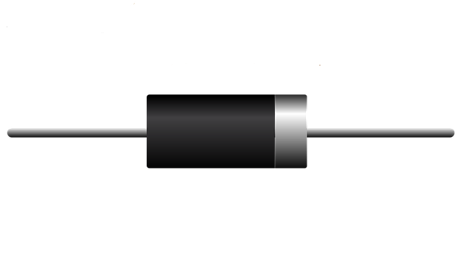
DIODE
A diode is a two-terminal electronic component that conducts current primarily in one direction (asymmetric conductance); it has low (ideally zero) resistance in one direction, and high (ideally infinite) resistance in the other.
A diode vacuum tube or thermionic diode is a vacuum tube with two electrodes, a heated cathode and a plate, in which electrons can flow in only one direction, from cathode to plate.

Slide 17
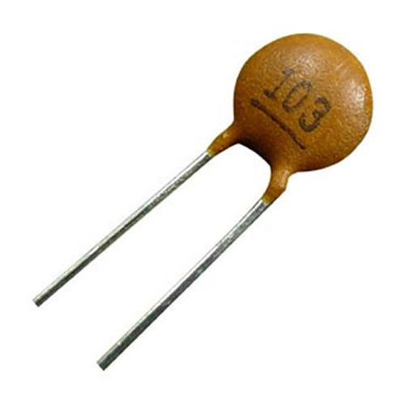
CAPACITOR
A capacitor is a device that stores electrical energy in an electric field. It is a passive electronic component with two terminals.
The effect of a capacitor is known as capacitance. While some capacitance exists between any two electrical conductors in proximity in a circuit, a capacitor is a component designed to add capacitance to a circuit. The capacitor was originally known as a condenser or condensator .
This name and its cognates are still widely used in many languages, but rarely in English, one notable exception being condenser microphones, also called capacitor microphones.

Slide 18
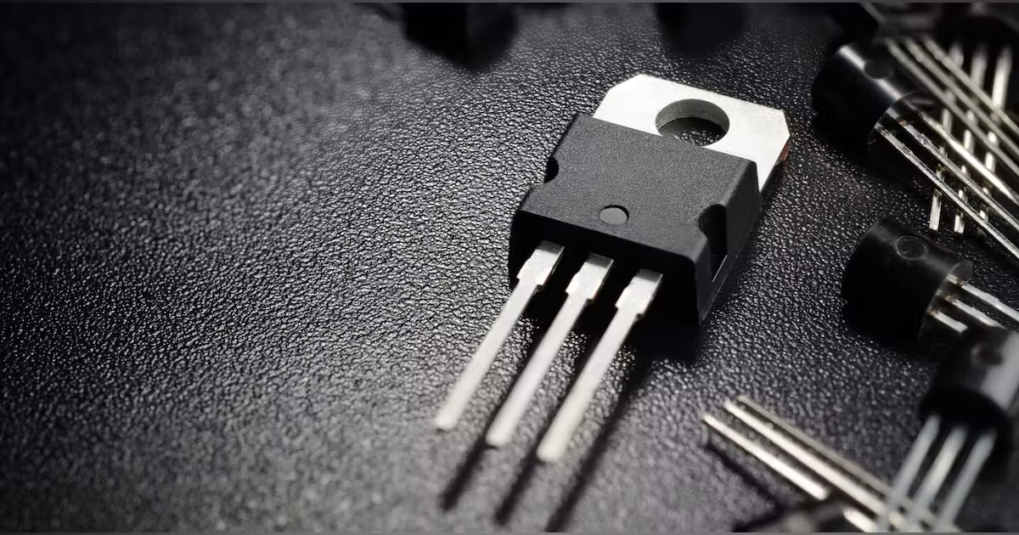
TRANSISTOR
A transistor is a semiconductor device used to amplify or switch electrical signals and power.
The transistor is one of the basic building blocks of modern electronics.^{[1]} It is composed of semiconductor material, usually with at least three terminals for connection to an electronic circuit.
A voltage or current applied to one pair of the transistor's terminals controls the current through another pair of terminals. Because the controlled (output) power can be higher than the controlling (input) power, a transistor can amplify a signal.
Some transistors are packaged individually, but many more are found embedded in integrated circuits.

Slide 19
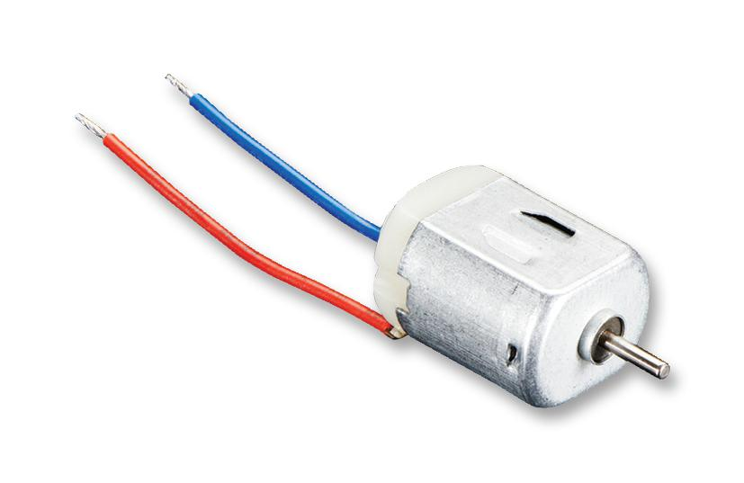
DC MOTOR
A DC motor is any of a class of rotary electrical motors that converts direct current (DC) electrical energy into mechanical energy.
The most common types rely on the forces produced by magnetic fields.
Nearly all types of DC motors have some internal mechanism, either electromechanical or electronic, to periodically change the direction of current in part of the motor.

Slide 20
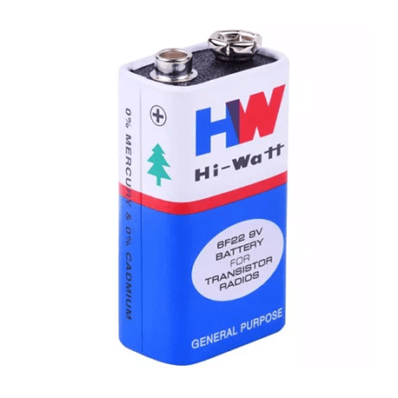
BATTERIES
An electric battery is a source of electric power consisting of one or more electrochemical cells with external connections for powering electrical devices.
When a battery is supplying power, its positive terminal is the cathode and its negative terminal is the anode.
The terminal marked negative is the source of electrons that will flow through an external electric circuit to the positive terminal.

Slide 21
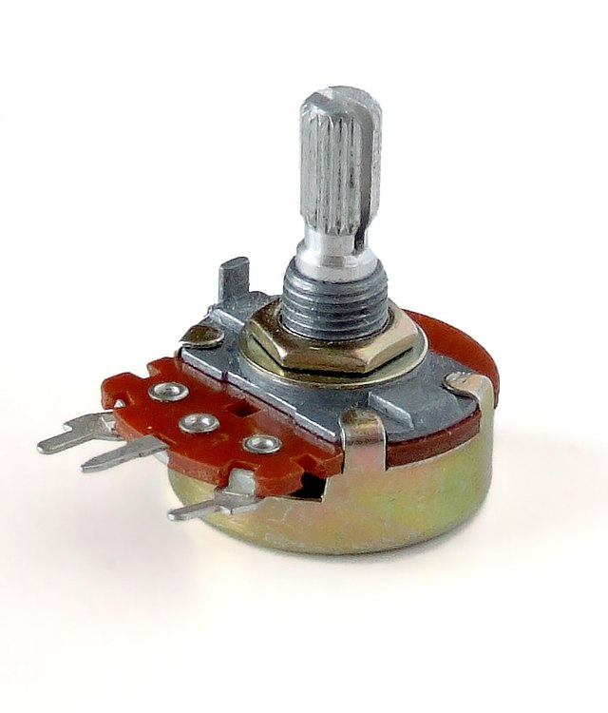
POTENTIO METER
A potentiometer is a three-terminal resistor with a sliding or rotating contact that forms an adjustable voltage divider.
If only two terminals are used, one end and the wiper, it acts as a variable resistor or rheostat.
The measuring instrument called a potentiometer is essentially a voltage divider used for measuring electric potential (voltage) .

Slide 22
Circuit diagram

Slide 23
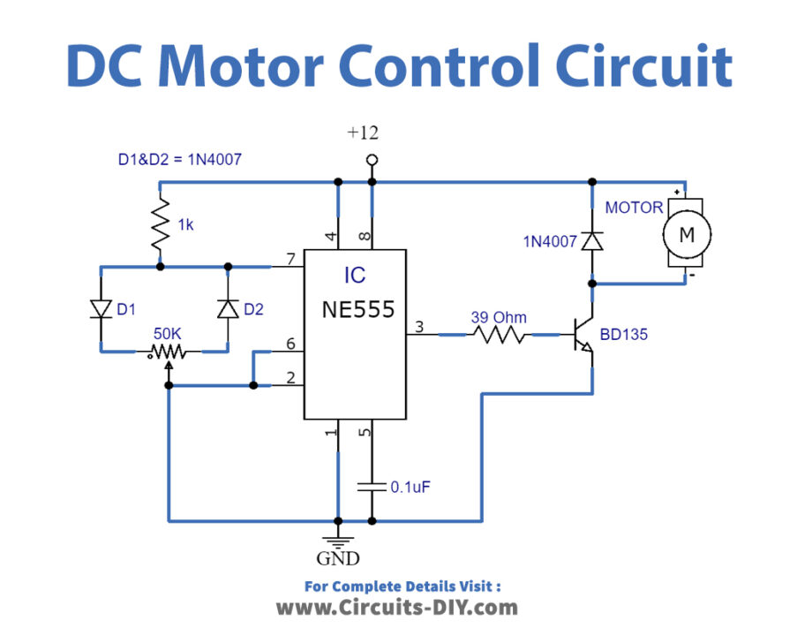
CIRCUIT DIAGRAM

Slide 24
working

Slide 25
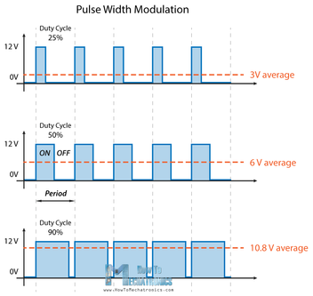
WORKING
PWM (Pulse Width Modulation) One method that is often used for DC motor control using a microcontroller is Pulse Width Modulation (PWM) method.
The speed of the electric motor depends on the modulator voltage.
The greater the voltage, the faster the rotation of an electric motor.
PWM is a good technique for controlling analog circuits of the motor drive with digital outputs from a microcontroller.

Slide 26
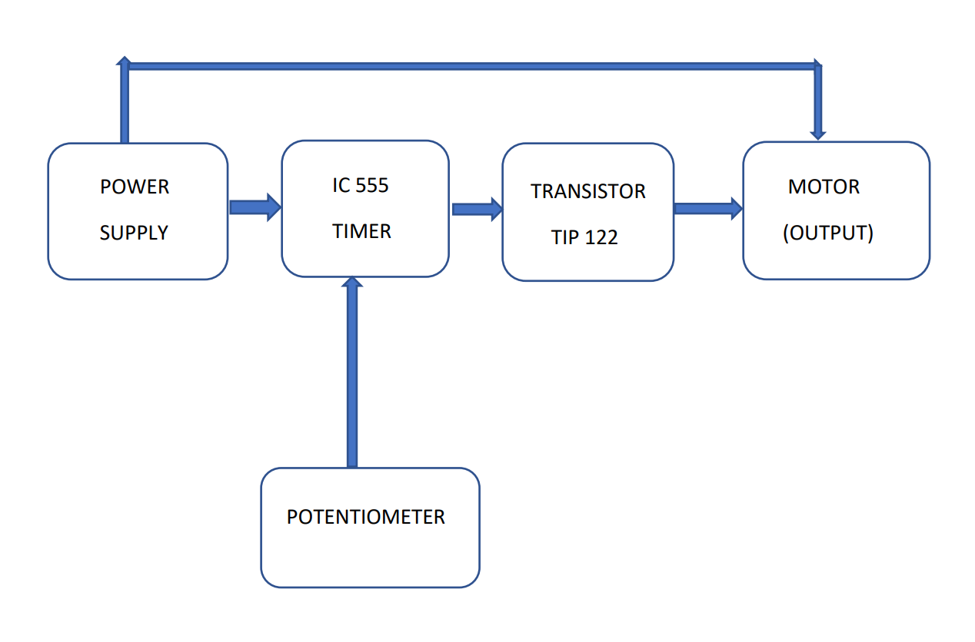
BLOCK DIAGRAM

Slide 27
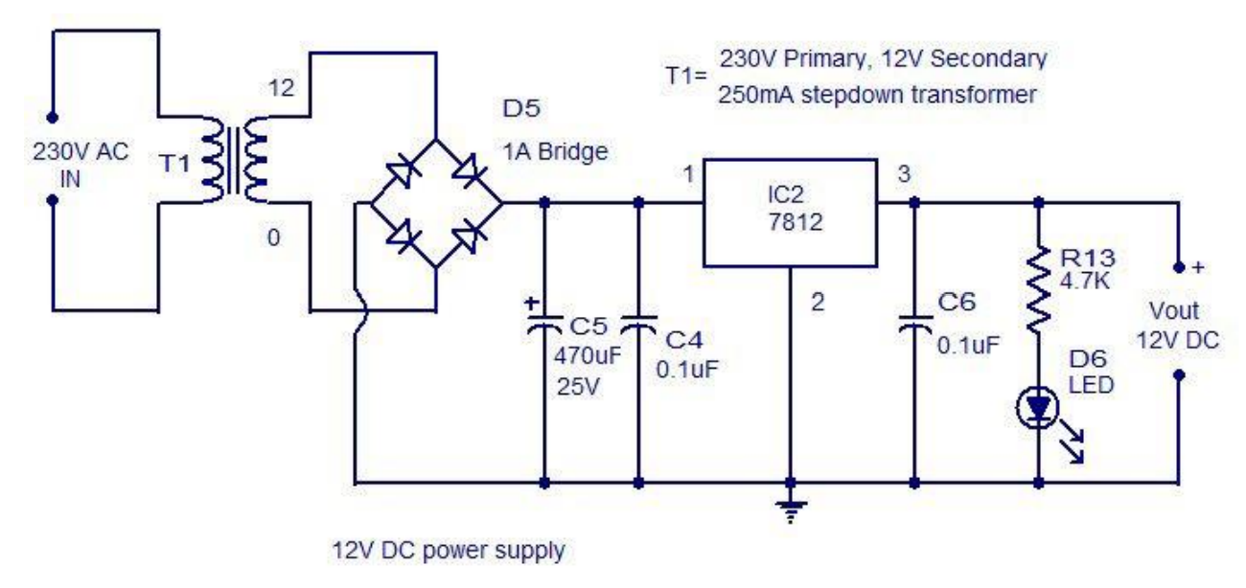
POWER SUPPLY
In this project, we are providing 12V supply to the circuit through 12-0-12 transformer using Capacitors, Voltage Regulator, Resistor, Diode and Led (Indicator).

Slide 28
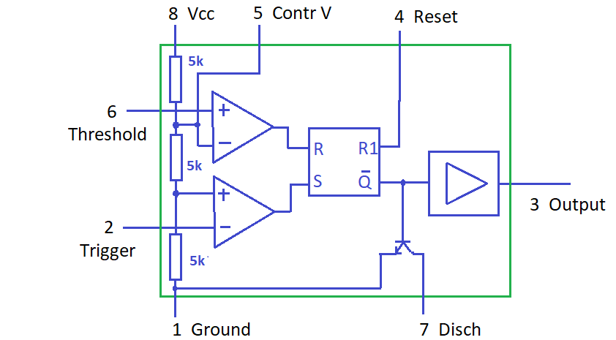
IC555 TIMER
The 555 generally operates in 3 modes:
1. Astable
2. Mono-stable
3. Bi-stable modes.
In this circuit, Astable mode is being used. This means there will be no stable level at the output. So, the output will be swinging between high and low.
This character of unstable output is used as a clock or square wave output for many applications.

Slide 29
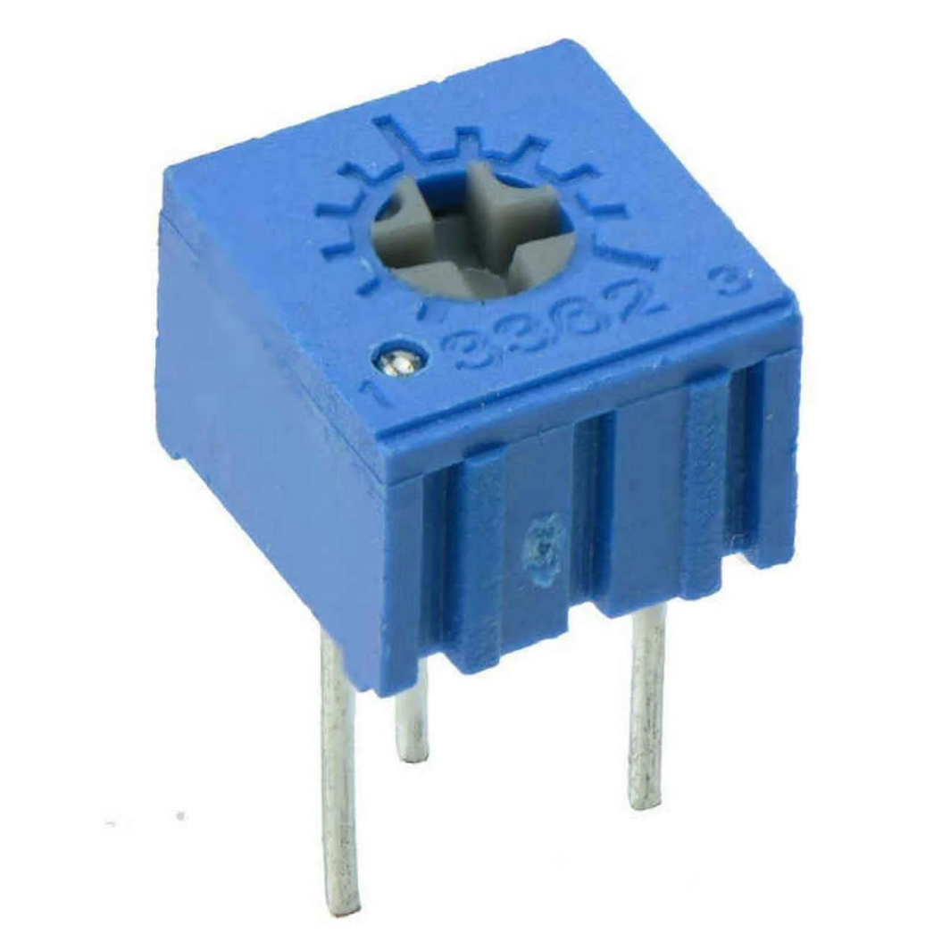
POTENTIOMETER
A potentiometer is a three-terminal resistor with a sliding or rotating contact that forms an adjustable voltage divider . If only two terminals are used, one end and the wiper, it acts as a variable resistor or rheostat.
In this project, we use 100 KΩ potentiometer

Slide 30
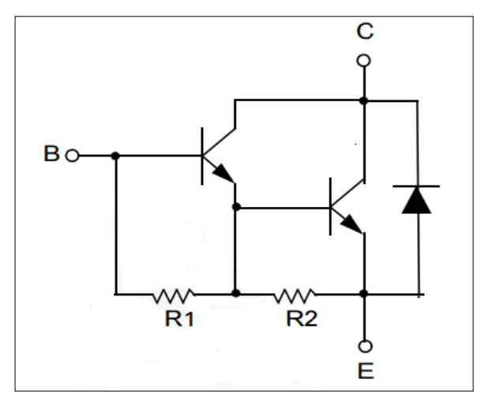
TRANSISTOR
In this circuit, we use TIP122 (Darlington NPN) transistor.
The TIP122 is a Darlington pair NPN transistor.
It functions like a normal NPN transistor, but since it has a Darlington pair inside it has a good collector current rating of about 5A and a gain of about 1000.
It can also withstand about 100V across its collector- Emitter hence can be used to drive heavy loads.
This increases the current gain and current rating of this transistor.

Slide 31
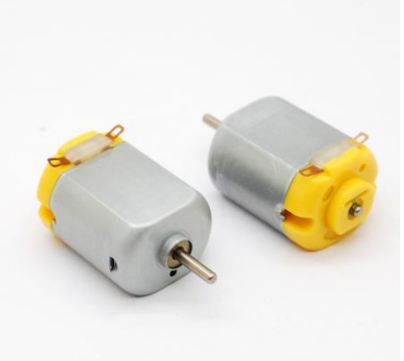
DC MOTOR
A DC motor is any of a class of rotary electrical machines that converts direct current electrical energy into mechanical energy.
The most common types rely on the forces produced by magnetic fields.
Nearly all types of DC motors have some internal mechanism, either electromechanical or electronic, to periodically change the direction of current flow in part of the motor.
In this project, we use 12V DC motor

Slide 32
simulations

Slide 33
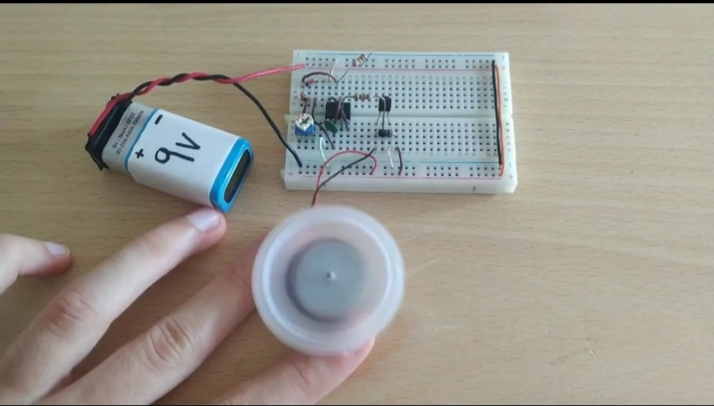
BREAD BOARD CIRCUIT

Slide 34
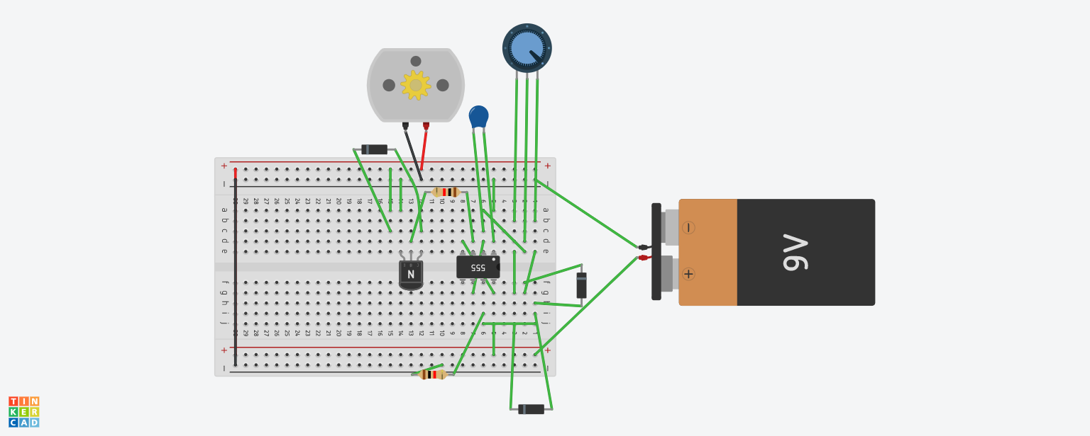
Tinker Cad

Slide 35
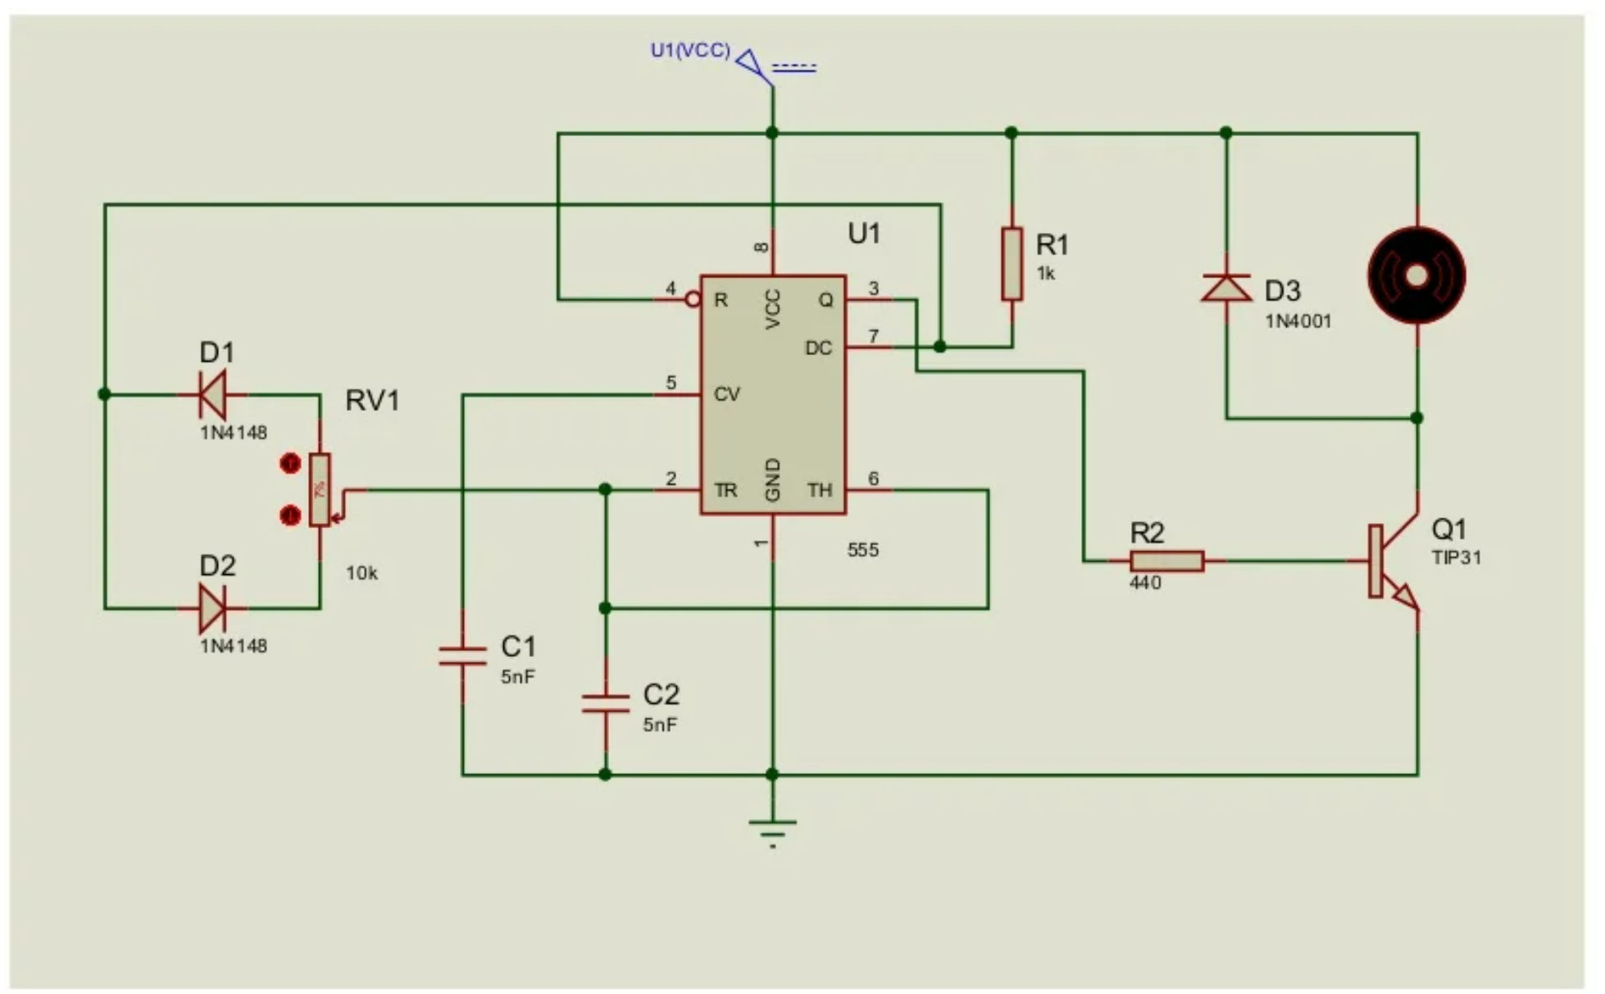
PROTEUS DIAGRAM

Slide 36
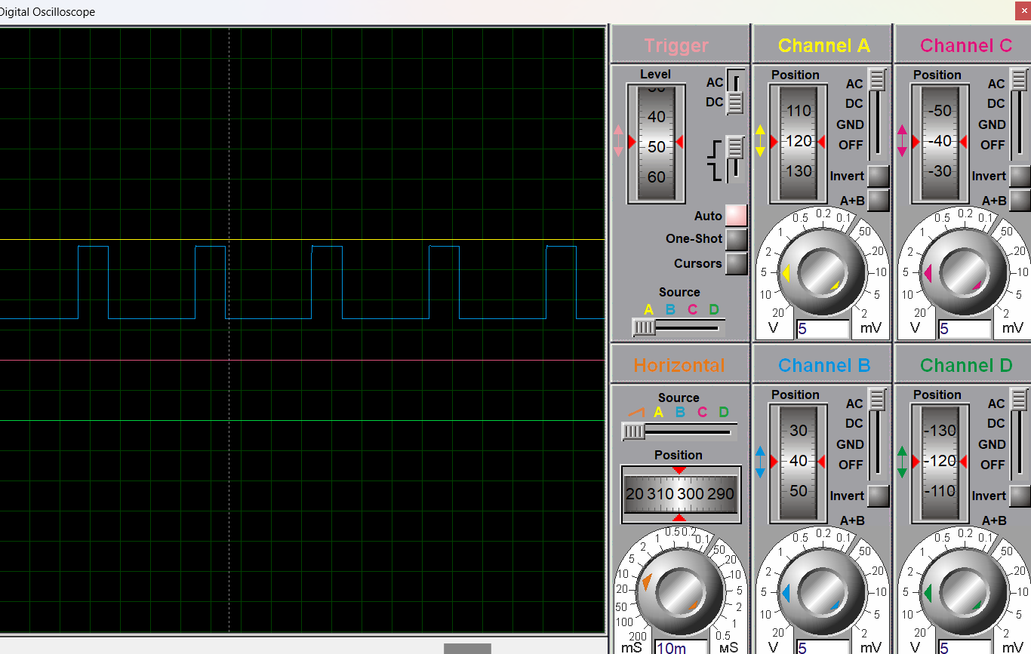
Proteus Oscilloscope

Slide 37
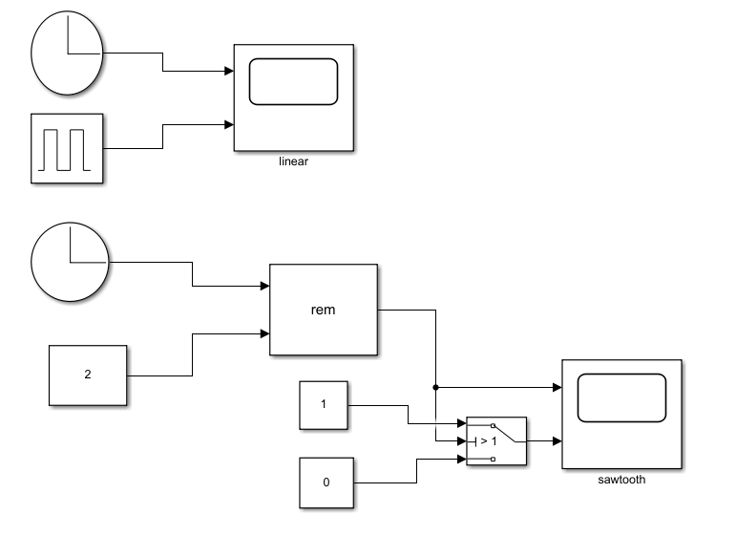
PWM SIGNAL IN MATLAB
SAWTOOTH IN MATLAB:
In the 1st block we have considered and
linear clock signal and a PWM signal
and have observed their waveforms.
In the 2nd block we have a consider a
linear signal and a constant valve and
sent their signal into reminder block
which generates a sawtooth ad further
sent into switch if switch is 1 we will
get PWM signal if switch is 0 there will be
no genration of signal.

Slide 38
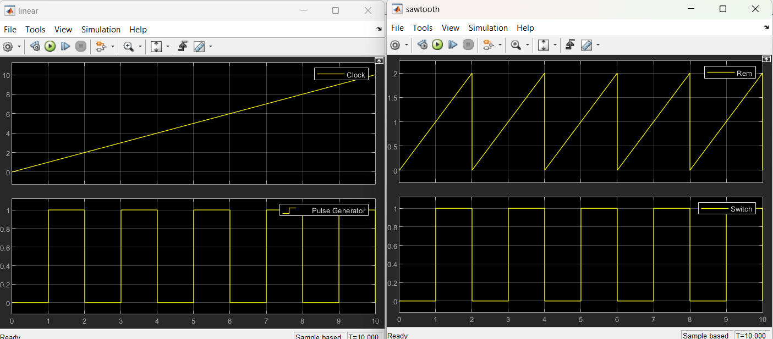
WAVE FORM

Slide 39
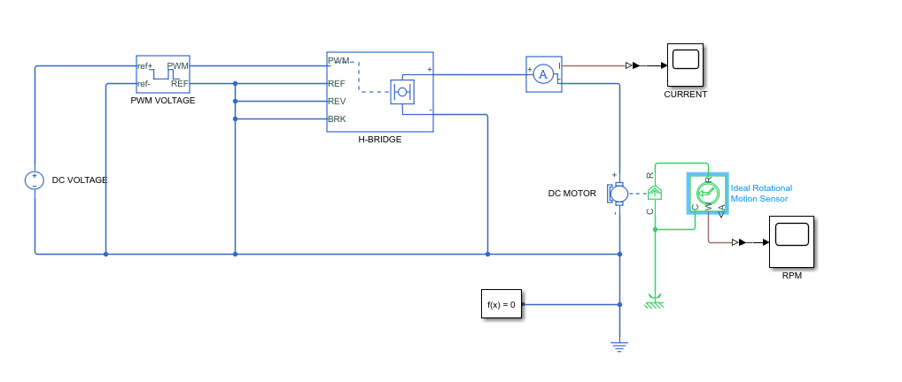
PWM-Controlled DC Motor using Mat-lab

Slide 40
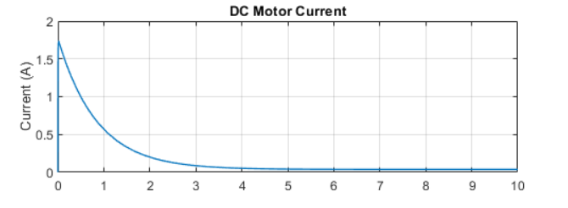
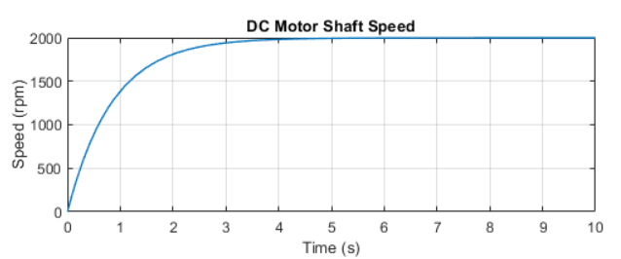
OBSERVATIONS

Slide 41
Advantages and disadvantages

Slide 42
ADVANTAGES AND DISADVANTAGES
The main advantage of PWM is that power loss in the switching devices is very low.
When a switch is off there is practically no current, and when it is on and power is being transferred to the load, there is almost no voltage drop across the switch.
The pulse width modulation technique is the reduction of higher order harmonics.
It also makes it possible to control the magnitude of the output voltage, and improve the power factor by forcing the switches to follow the input voltage waveform using a PLL loop.

Slide 43
Applications

Slide 44
APPLICATIONS
A DC motor, when the load (torque) Of the motor is constant, the Speed is proportional to the power supply voltage.
The Output voltage level is determined by the duty cycle Of P\VNI, thus the PYM Can be used to control the speed Of the motor.
PWM Techniques are used in Telecommunications for encoding purposes.

Slide 45
Precautions

Slide 46
PRECAUTIONS
Care must be taken while soldering the circuit on printed circuit board or bread board.
We should aware of choosing a battery of a certain low voltage of a range of 6-12 volts to get rid of any overloading conditions.
Take care while connecting wires on brad-board.
Take care while connecting motor on bread-board.

Slide 47
conclusion

Slide 48
CONCLUSION
A simple project for generating PWM Signal using 555 Timer IC to control the speed of a DC Motor.
The speed of the electric motor depends on the modulator voltage. The greater the voltage, the faster the rotation of an electric motor.
Speed control of DC motor can be achieved using Analog pulse Width Modulation technique.
Using analog PWM, control can be obtained over a wide range of values.
In that proposed method , duty cycle is varied from 0 percent to 90 percent and motor is controlled at different speeds.
At 50 percent of duty cycle , speed of DC motor is observed to be half of that at full voltage.

Slide 49
resources

Slide 50
RESOURCES
Matlab official documentation on PWM signal,IC 555 timer.
https://ijcrt.org/papers/IJCRT2205843.pdf.

Slide 51


